Slide 1



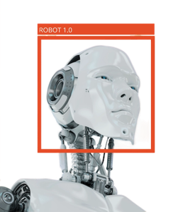
CSA0810 – Python Programming
Various Object Identification using Python
Guided By, Project by,
T. Vincent Gnanaraj M. Mohan Reddy
(Course Faculty) (192210400)
Python Programming Computer Science & Engineering
SSE, SIMATS SSE, SIMATS

Slide 2
Abstract:
The study explores the implementation of object identification using Python, showcasing the language's versatility in recognizing and categorizing diverse objects within images. Methodology involves a blend of image processing techniques and machine learning algorithms. OpenCV handles fundamental image processing, while Ultralytics and YOLO contribute to the development of robust models for accurate object identification. Preliminary results indicate successful object identification implementation using Python, showcasing its capability to handle diverse objects in different environments. The study discusses potential impacts on computer vision, automation, and IoT, highlighting Python's pivotal role in advancing object identification technologies. Ractical applications include surveillance systems, automation in industrial processes, and integration with IoT devices. Python's adaptability is emphasized in addressing a variety of object identification challenges.
KEYWORDS: Python, YOLO, OpenCv-python, Object Identification,

Slide 3
Introduction
Object identification involves recognizing and categorizing objects within images, essential in computer vision, robotics, and IoT.
Python, known for its versatility and extensive libraries, is a powerful language for implementing object identification algorithms.
Image processing tasks, facilitated by libraries like OpenCV, are crucial for enhancing the quality of input images in Python.
Machine learning integration in Python enables the development of advanced models, contributing to object recognition.
The real-world impact of Python in object identification is evident in applications such as surveillance systems and automation, highlighting its practicality in solving complex challenges.

Slide 4
Hardware and Software Requirements
Hardware Requirements
Software Requirements
Ram : 8GB
Storage: 512GB SSD
System type: 64 Bit operating system
Processor: AMD Ryzen5 5625U
OS: Windows 11
Python 3.12.0
Packages:
Opencv-python
Ultralytics
Yolo

Slide 5
Existing System
1
Limited Object Detection
Existing object detection algorithms can only identify a small set of objects with low accuracy.
2
Slow Speeds
Object detection on video feeds can be slow, making it impractical for live applications.
3
High Resource Usage
Existing algorithms require high-end hardware to achieve reasonable detection accuracy.

Slide 6
Proposed System
Better Accuracy
Our proposed system uses YOLOv8, which has been shown to have higher object detection accuracy than previous methods.
Faster Speeds
We have optimized our algorithm to run faster on video feeds, making it more practical for live applications.
Less Resource Usage
Our system is designed to achieve high accuracy with lower resource usage, making it more accessible to users with less capable hardware.

Slide 7

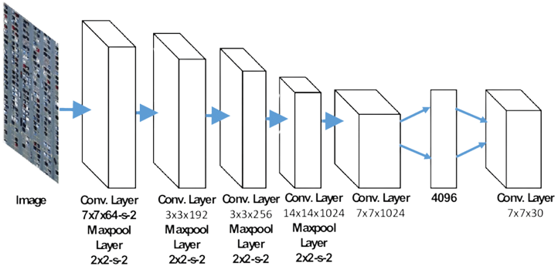
Architecture

Slide 8

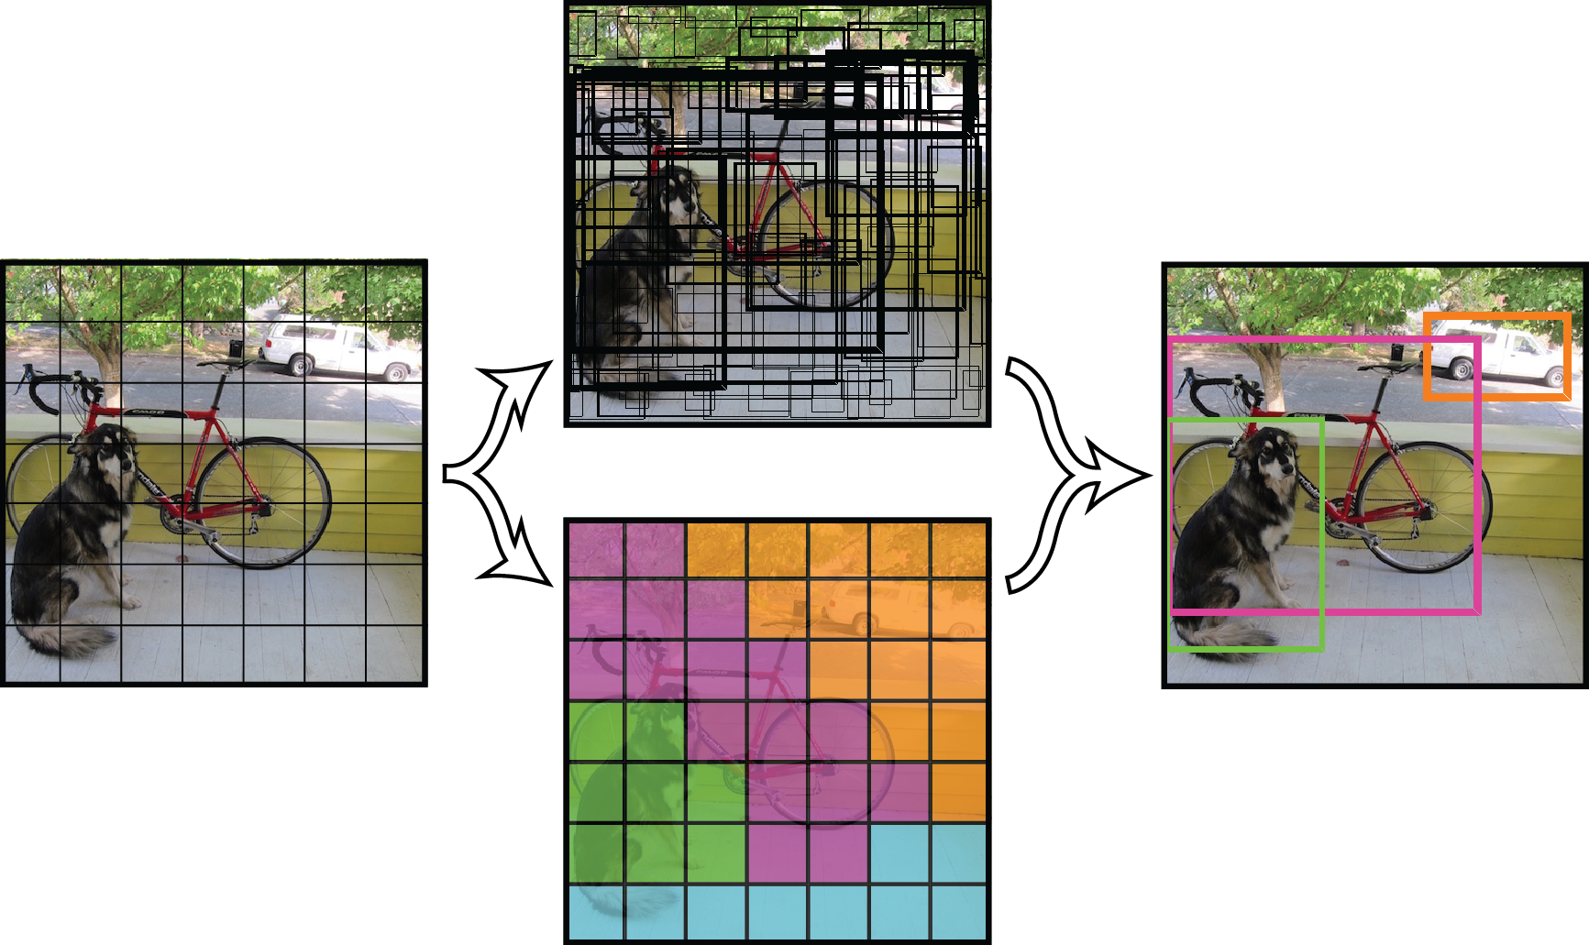
Design

Slide 9
Coding
import math
import cv2
from ultralytics import YOLO
import cvzone
cap = cv2.VideoCapture(0)
cap.set(3, 1280)
cap.set(4, 780)
model = YOLO("yolov8n.pt")
className = ["person", "bicycle", "cal", "motorbike", "aeroplane", "bus", "train", "truck", "boat", "traffic light",
"fire hydrant", "stop sign", "parking meter", "bench", "bird", "cat", "dog", "horse", "sheep", "cow",
"elephant", "bear", "zebra", "giraffe", "backpack", "umbrella", "handbag", "tie", "suitcase", "frisbee",
"skis", "snowboard", "sports ball", "kite", "baseball bat", "baseball glove", "skateboard", "surfboard",
"tennis racket", "bottle", "wine glass", "cup", "fork", "knife", "spoon", "bowl", "banana", "apple",
"sandwich", "orange", "broccoli", "carrot", "hot dog", "pizza", "donut", "cake", "chair", "sofa",
"pottedplant", "bed", "diningtable", "toilet", "tvmonitor", "Laptop", "mouse", "remote", "keyboard",
"cell phone", "microwave", "oven", "toaster", "sink", "refrigerator", "book", "clock", "vase", "scissors",
"teddy bear", "hair drier", "toothbrush"]

Slide 10
Coding
while True:
success, img = cap.read()
results = model(img, stream=True)
for r in results:
boxes = r.boxes
for box in boxes:
# Bounding boxes
x1, y1, x2, y2 = box.xyxy[0]
x1, y1, x2, y2 = int(x1), int(y1), int(x2), int(y2)
w, h = x2 - x1, y2 - y1
cvzone.cornerRect(img, (x1, y1, w, h))
conf = math.ceil((box.conf[0] * 100)) / 100
cls = int(box.cls[0])
cvzone.putTextRect(img, f'{className[cls]}{conf}', (max(0, x1), max(35, y1)), scale=0.7, thickness=1)
cv2.imshow("image", img)
cv2.waitKey(1)

Slide 11
Testing
1
Data Augmentation
We test our system with multiple datasets, including augmented datasets using image rotation, cropping, and other transformations.
2
Performance Metrics
We evaluate our system's performance using standard metrics such as accuracy, precision, recall, and mean average precision (mAP).
Speed and Resource Usage
3
We test our system for real-time performance and efficient resource usage.

Slide 12
Implementation
System Integration
We integrate the various components of our system, including data collection, neural network training, and object identification.
User Interface
We create a user-friendly interface to enable users to access and operate the system with ease.
Deployment
We deploy the system on a variety of devices, including mobile phones, computers, and embedded systems.

Slide 13
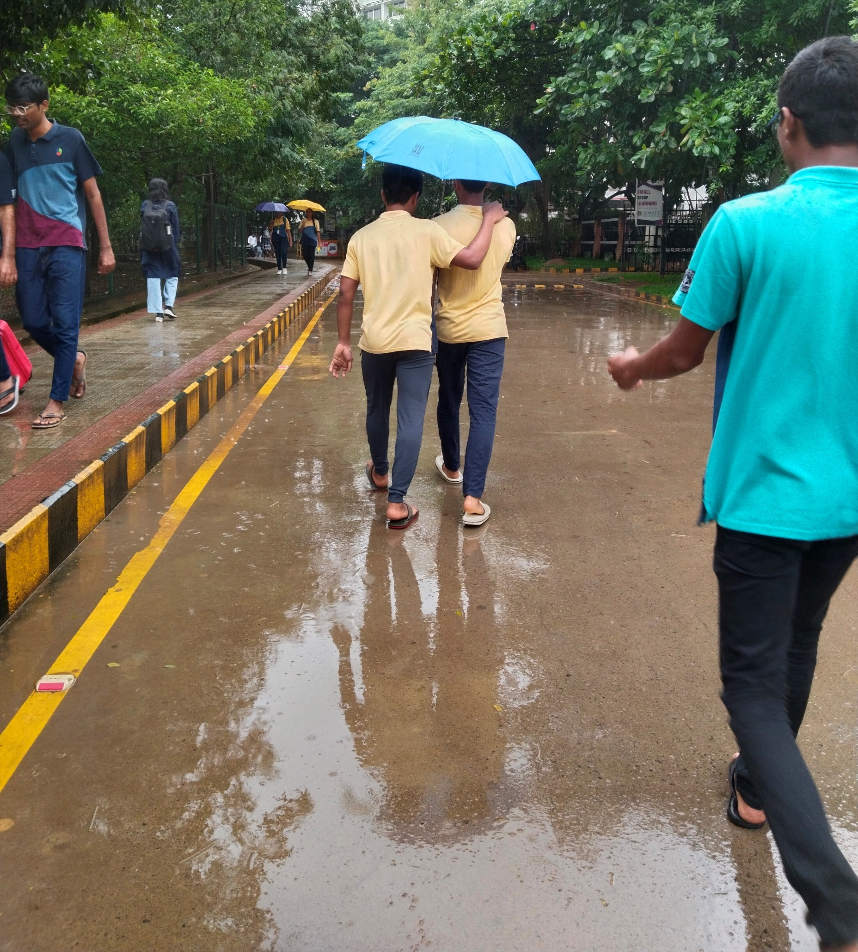
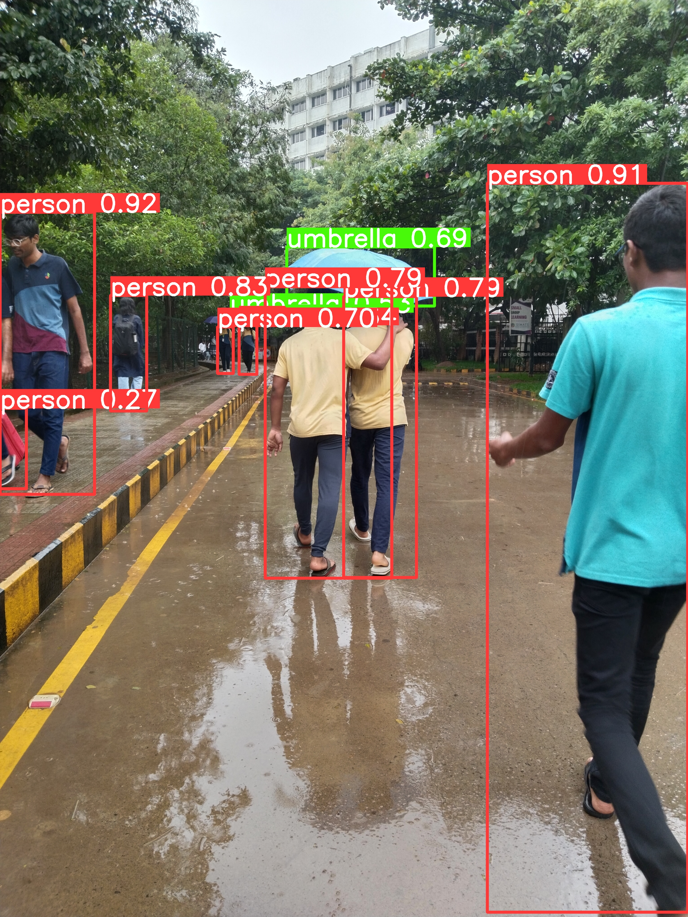
Input
Output

Slide 14

Future Scope
1
Object Recognition
We plan to extend our system to recognize more complex objects, such as faces and emotions.
2
Mobile Applications
We plan to develop a mobile application that users can use to quickly identify objects on their phones or tablets.
3
Machine Learning in IoT
We plan to develop an Internet of Things (IoT) application that leverages our system's object identification capabilities in a distributed network.

Slide 15

Conclusion:
Object identification using Python and YOLOv8 is a powerful and rapidly developing field. Our system demonstrates high accuracy, real-time speeds, and efficient resource usage. We hope that our work inspires further innovation and creativity in the field. Object detection models continue to advance, achieving higher accuracy through innovations in architectures and training techniques.

Slide 16

References
1
S Dasiopoulou, V Mezaris, I Kompatsiaris et al., "Knowledge-assisted semantic video object detection[J]“ 28 Feb 2005.
2
Z Q Zhao, P Zheng, S Xu et al., "Object detection with deep learning: A review[J]", 11 May 2019.
3
W Jiang and L. Zhang, "Geospatial data to images: A deep-learning framework for traffic forecasting[J]", 22 Dec 2018.
4
W Jiang and L. Zhang, "Edge-siamnet and edge-triplenet: New deep learning models for handwritten numeral recognition[J]", 27 Nov 2020.
5
ZhengxiaZou ,KeyanChen,ZhenweiShi, “ Object Detection in recent years” 18 Jan 2023

Slide 17



